Slide 1
Advance Internship@Clevered
AI App/ EcoLit Quiz
App User Manual
Author: Advika Parmar

Slide 2
Table of Contents
Acknowledgements
About Me
My Internship with Clevered
About App
How to use the app?
Contact

Slide 3
Acknowledgements
A big thank you to everyone who has assisted me in this journey, Miss Mani, Dr. Ken, my family and friends. This project would not be the same without their support.

Slide 4
About Me
Student’s Photograph
Student’s Introduction
I’m a student of Class 12, passionate about giving back to society, making a difference, badminton and theatre!

Slide 5
About My Internship with Clevered
My experience with Clevered has been phenomenal, right from the Warm Up to the Mentorship Session, each class was so informative and engaging, it made learning something new super exciting and motivating
Badges Earned - Rockstar for Innovation

Slide 6
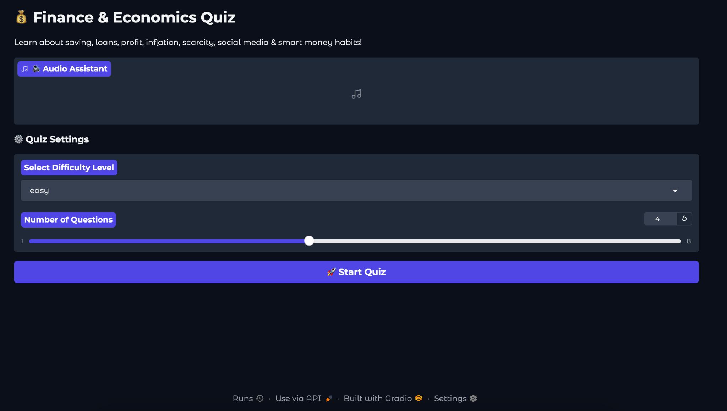
About App
This is a finance and economics quiz generator app, where there are three levels of difficulty and upto 8 questions per level. The user can chose the difficulty level and the number of questions.

Slide 7
How do I use the App?
The app is extremely easy to use, it has interactive and user-friendly interface which makes it a smooth experience.
After the first slide, the questions appear one by one and simultaneously Voice-to-Text gets activated, reading the questions and the options.
After the selection of answer, an explanation is provided for each question.
Finally, the results are shown with topics that need to be revised and revisited.

Slide 8
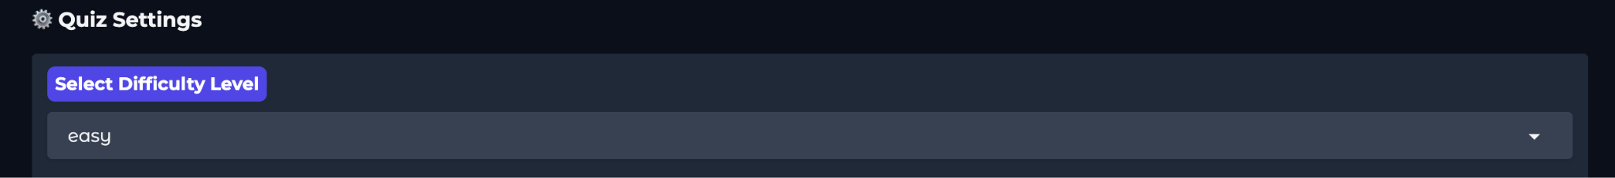
Drop Down
This allows the user to choose the level of difficulty

Slide 9
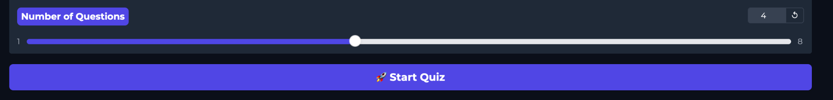
Slider and Start Button
This allows the user to choose the number of questions and start the quiz

Slide 10
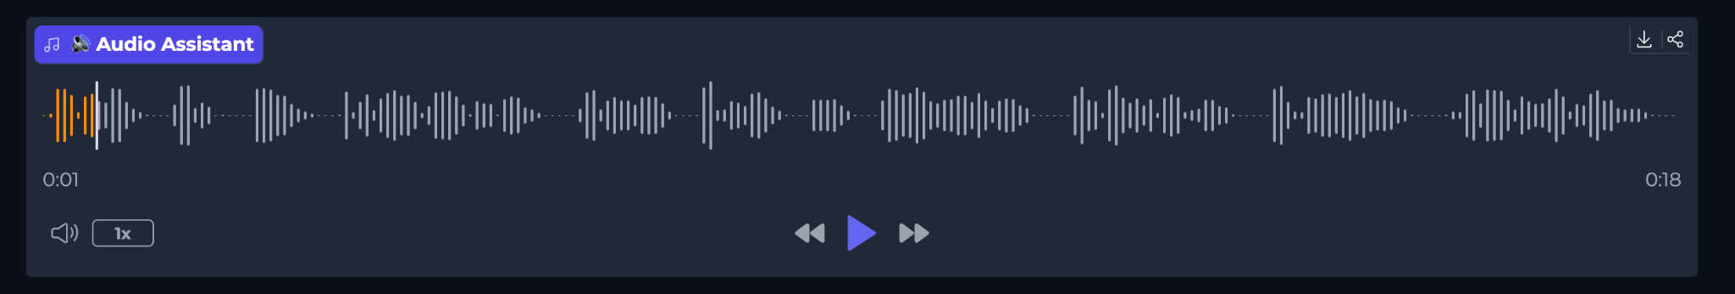
Text-to-Speech Option
This allows the user to listen to the question and options aurally, there is a volume and speed button as well.
The user has an option to rewind, forward and pause the audio and download it aswell

Slide 11
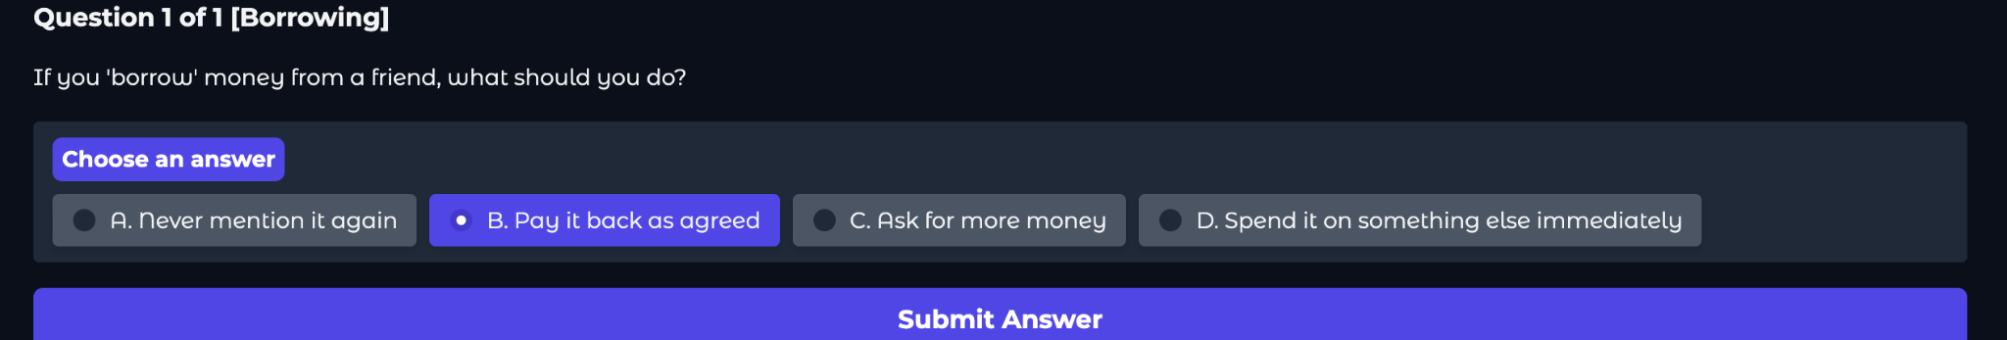
Answer Choice and Submit
The user can select the answer of choice and click on the submit button.

Slide 12
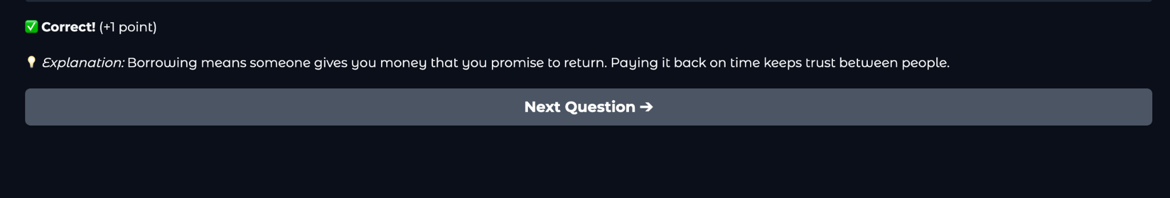
Next Question
Next Question button allows the user to move to the next question after going through the points and explanation

Slide 13
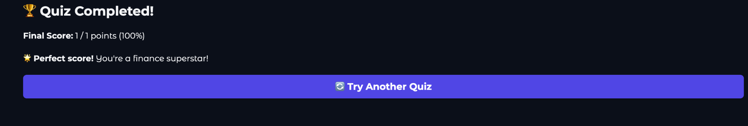
Try Another Quiz
Next Question button allows the user to try another quiz at different difficulty and number of question.

Slide 14
Contact Person
Advika Parmar -
Email - advika.parmar501@gmail.com
Mobile Number - 91 9422094365

Slide 15
Thank you!

